Slide 1

Welcome
Presented by:
Vani V Nair[Team Lead]
Vedashree V
Yamuna M
Vimala B K
[East West Institute of
technology]
Under the guidance of :
Mr Goutham
Mr Naga Mahesh
[Infidata Technologies]

Slide 2

About Infidata
InfiData Technologies head quartered in "silicon valley" of India Bengaluru,started in the year 2015. We are highly specialized in the design and development of websites,software application development,mobile app development,E-Commerce solutions and more. Our team of expert professionals works on the latest software tools and technologies to give the best and promising services to our customers.We are equipped with the state-of-art work station in the software application development.

Slide 3

JOB PORTAL

Slide 4

PROJECT INTRODUCTION
In the current scenario, there is a rat race in each and every professional field. It is also true for job market. A job portal is a website dedicated for online information about recruiters as well as job seekers.
A job portal helps both the job seekers and recruiters finding the right organization for the employees. In the case of job seekers, according to their educational qualification, experience and their preferences, the job portal shows the list of companies to the job seeker. And, to the recruiters, provides the suitable candidates from a pool of lacks.

Slide 5
So, a job portal is the perfect online arena, where both the job seekers and the employers find their goal in the pursuit of getting a top notch company for the suitable candidates.

Slide 6

Software requirements
Any text editor like Notepad++, Sublime, Atom ,Brackets etc.
Web browsers like Mozilla Firefox,Google Chrome, Internet Explorer, Safari etc.
WAMP or XAMP.
Languages used :
HTML
CSS
Javascript
Jquery
Bootstrap
PHP
Mysql

Slide 7
PROJECT MODULES
The main users in the project can be categorized into three modules as follow:
1. Admin
2. Employer
3. JobSeeker
Definitions, Acronyms and Abbreviations :
1. Admin : The authorized person who controls all the network
2. Employer : Who creates vacancies
3. JobSeekers : The person who sell applies for job.

Slide 8
FUNCTIONAL REQUIREMENTS :
Admin :
1. Manage Job Seeker and Employer Profiles.
2. Add New Services, Related to Employers or Job Seekers.
3. Provide Roles and Authentication to Users.
4. Search jobs based on keywords, categories, locations etc.
5. Admin can Add/Edit/Delete/Approve/Disapprove any job.

Slide 9
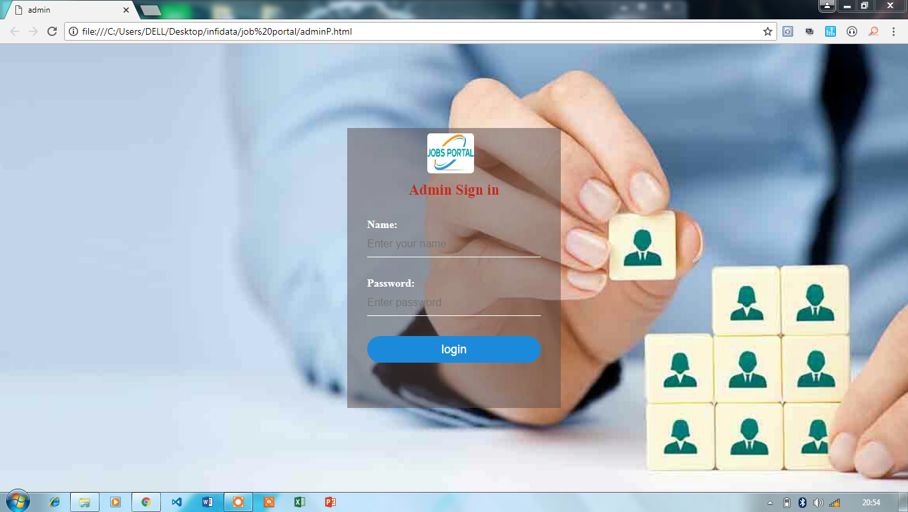
Admin sign in

Slide 10

Admin home page

Slide 11
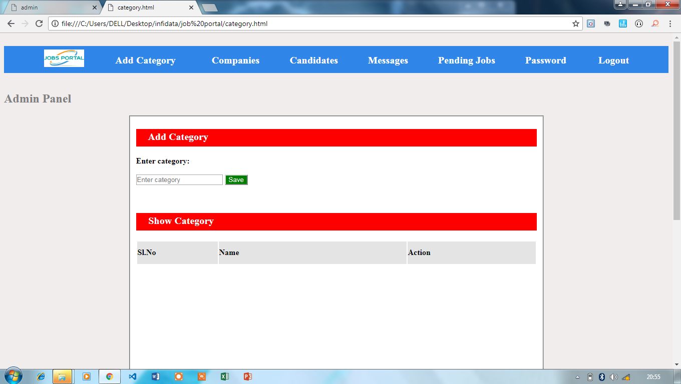
Add category

Slide 12
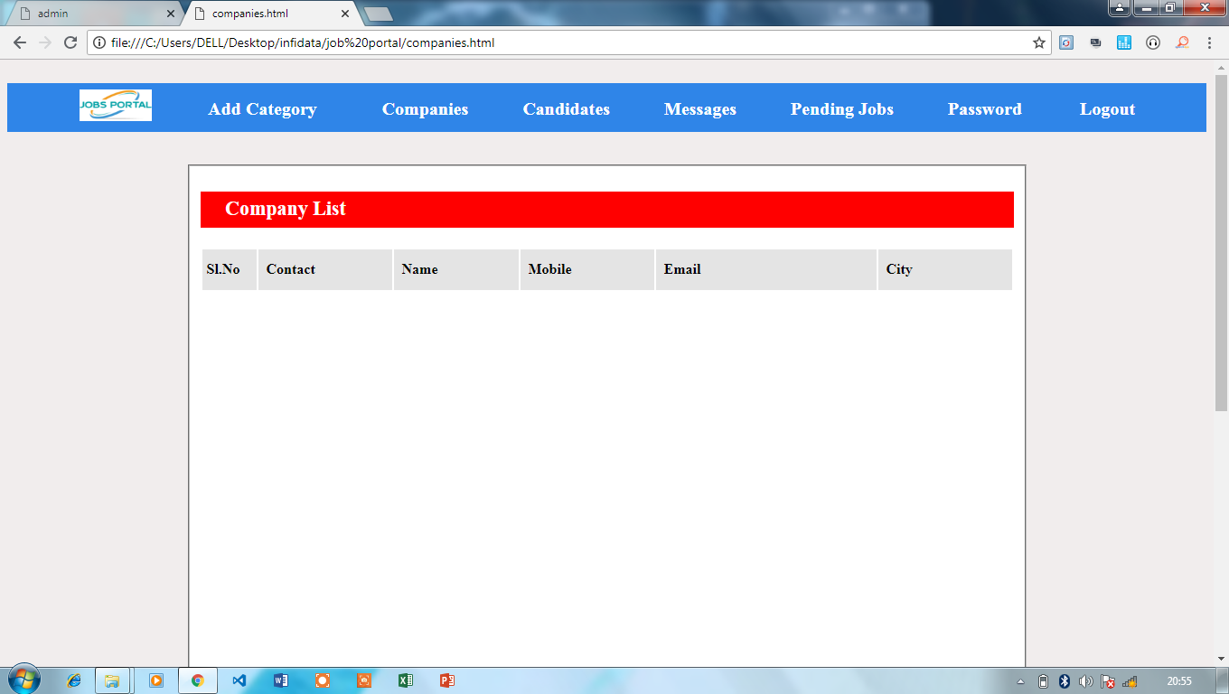
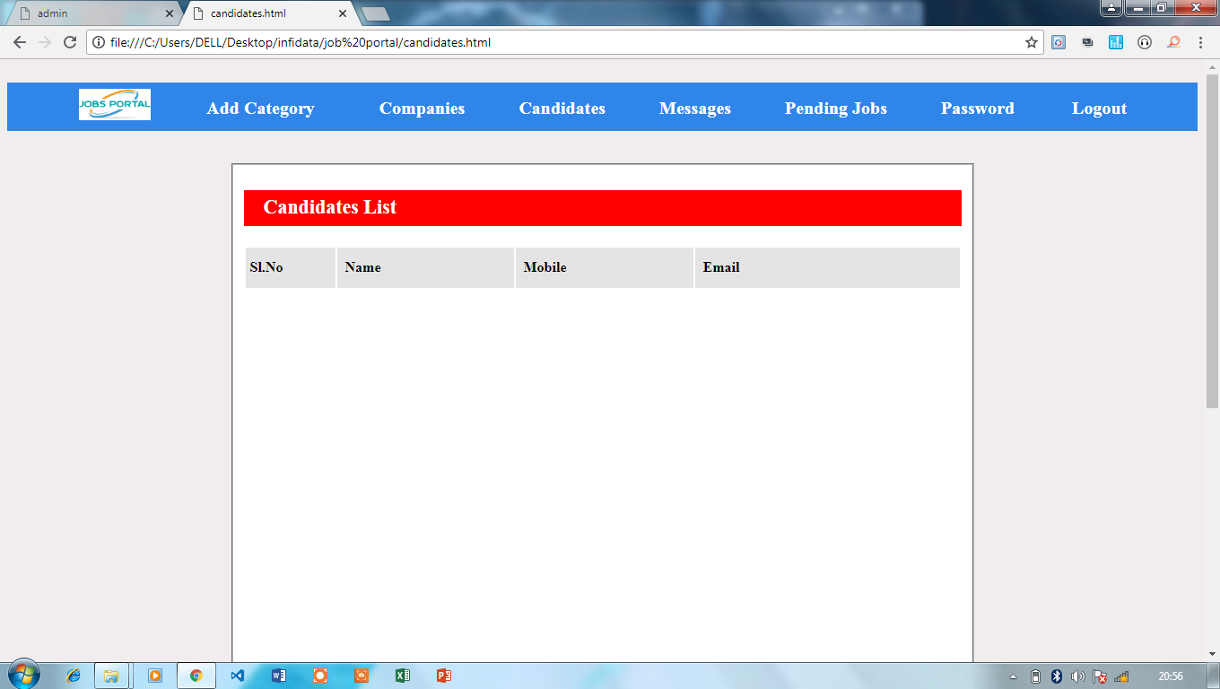
Company and Candidate list

Slide 13
2. Employer :
1. Ability to Search resume by keywords, job category, days since posted.
2. Post jobs with detailed job description (job title, company name, company url, location, salary,job type, work type, description, required skills...)
3. Ability to create and edit a company profile.
4. Ability to add a Company Logo.
5. Employer Registration
6. Register and sign-up online for Memberships, Job packages, job postings or resume database access.
7. Update profile at any time.
8. View Submitted Job Seeker CV
9. Download CV or application submitted by jobseekers

Slide 14
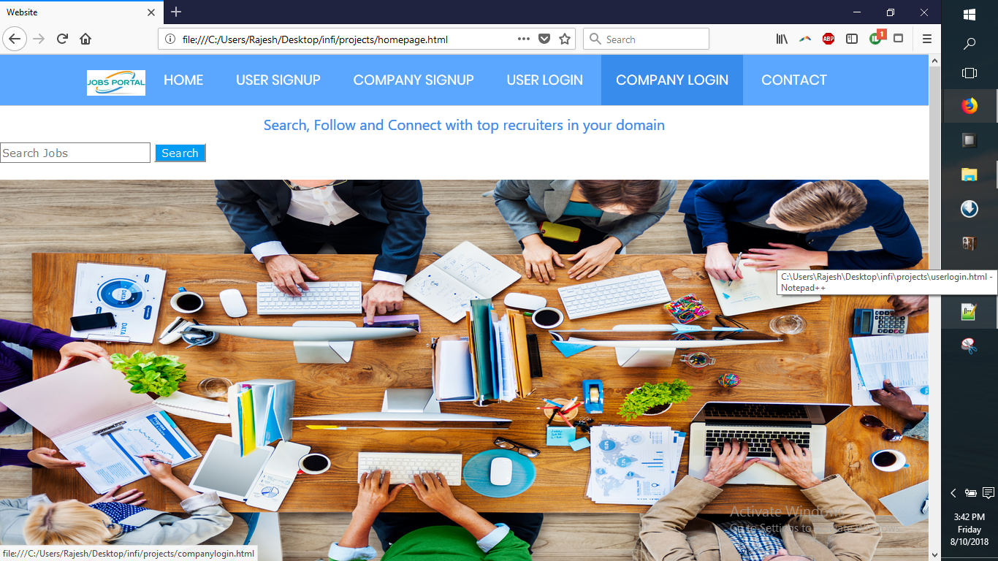
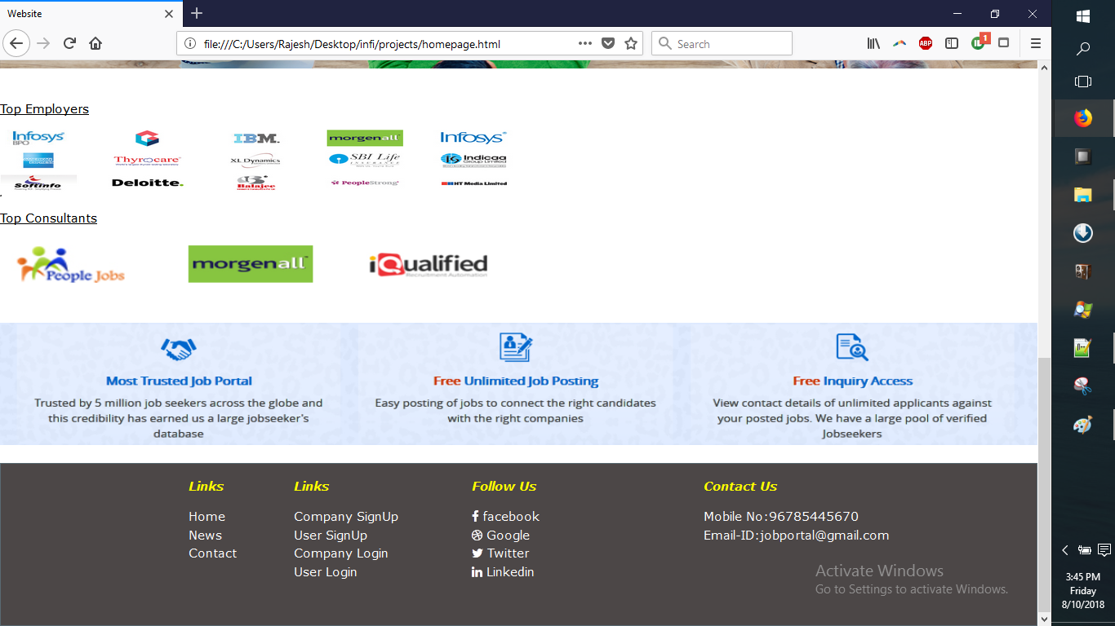
Home page

Slide 15
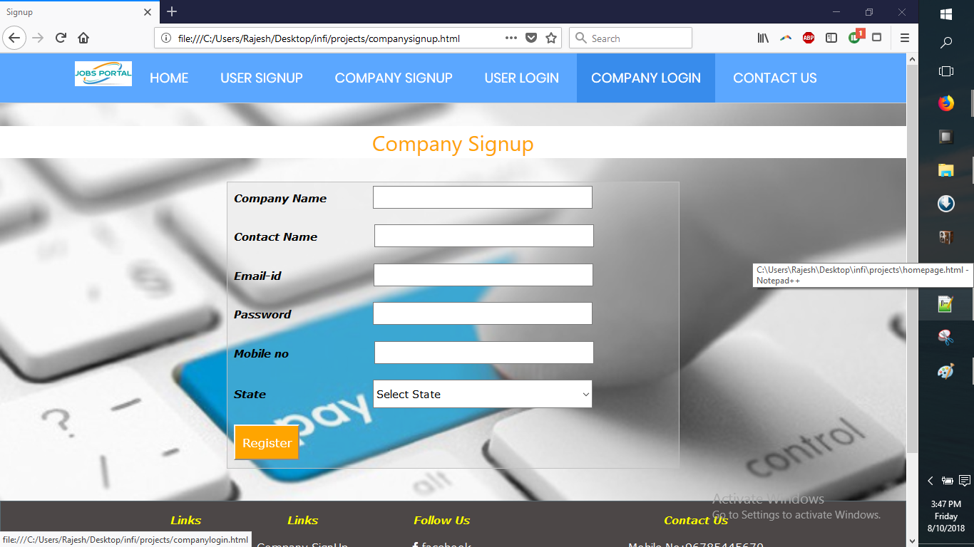
Company signup

Slide 16
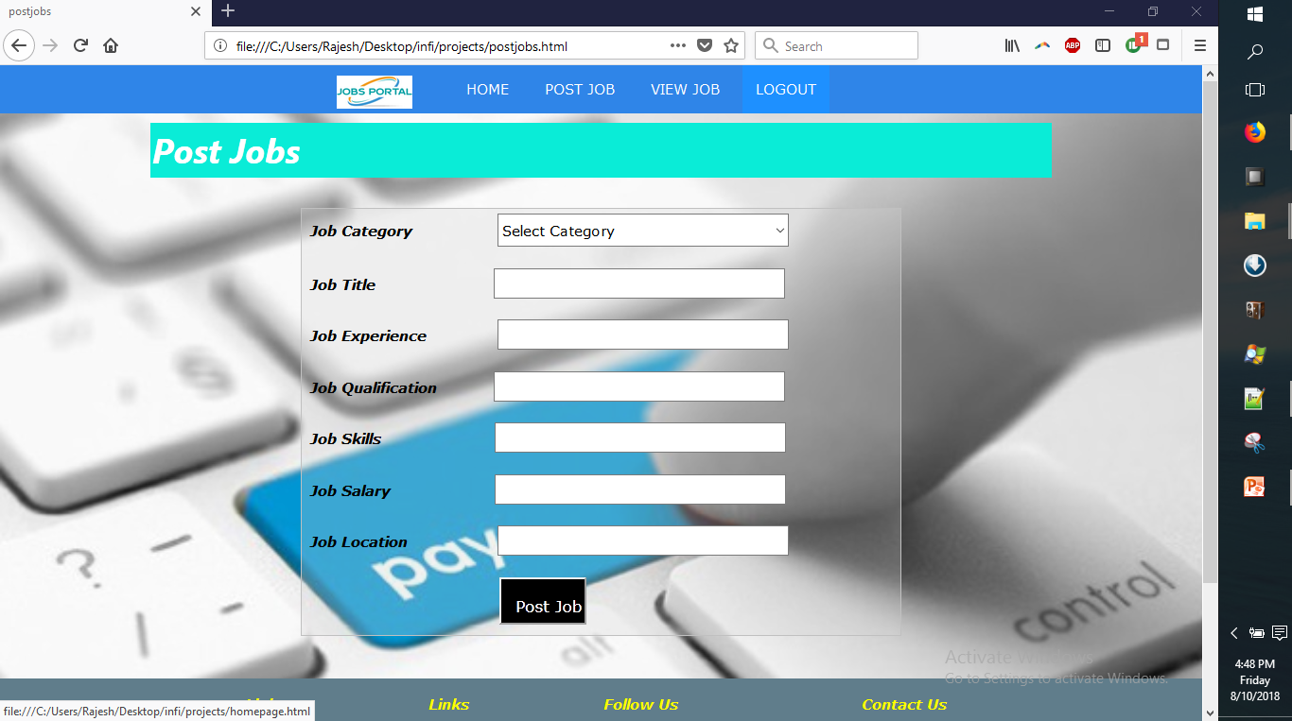
Post jobs

Slide 17
3.Job Seekers :
1. Apply for a job with the click of a button
2. Resume Posting.
4. Job Seeker Registration
5. View Application History from profile
6. Powerful online job search tool.
7. Search jobs by location, qualification, categories, company, location, experience and keywords.
8. Add multiple list of qualification and experience.
9. Ability to add and submit Photos to profile.

Slide 18
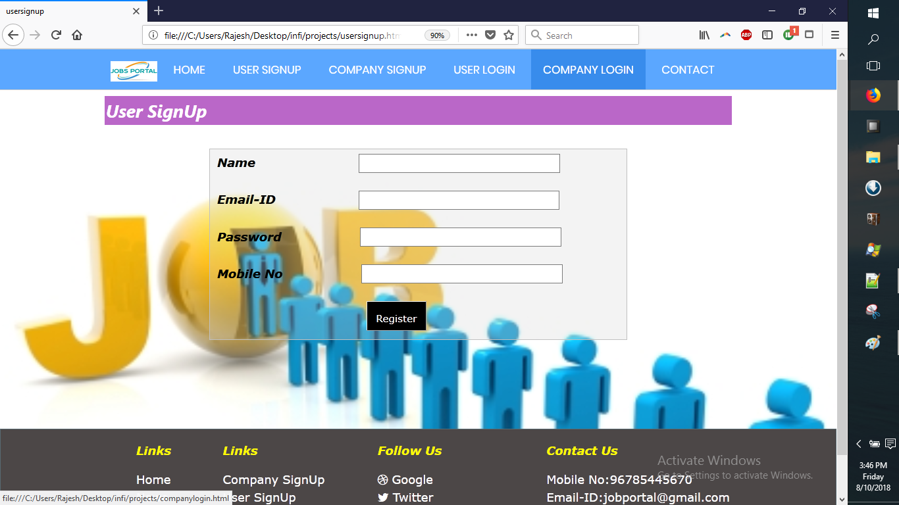
User sign up

Slide 19
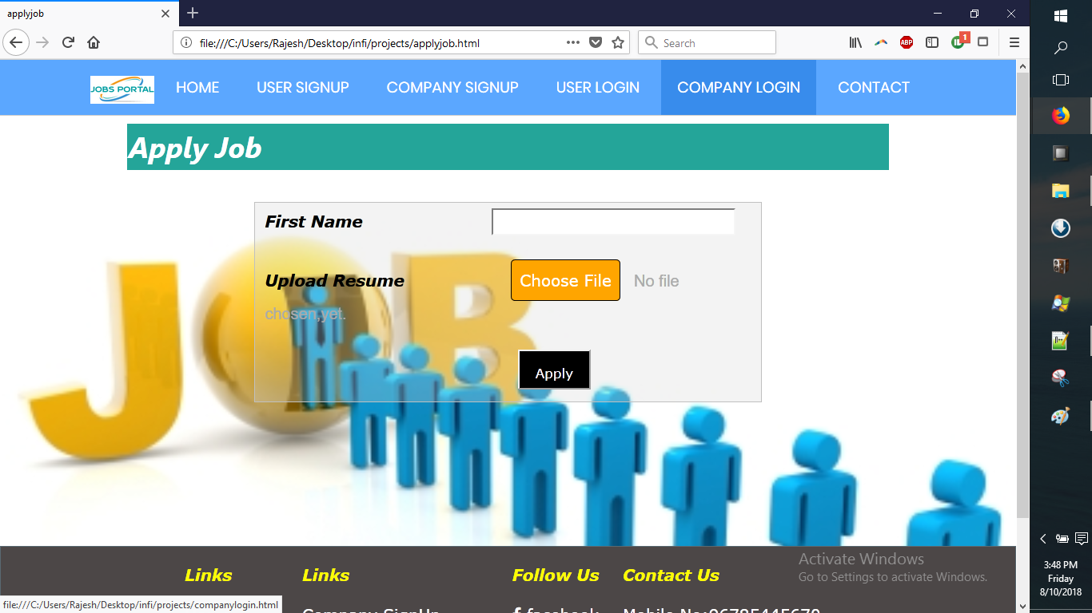
Apply job

Slide 20
Internship Individual Roles
Employer and Job Seeker :
Vani V Nair - Home page,headers,entire employer part.
Yamuna M – Home page footer, profile, entire job seeker part.
Admin part :
Vedashree V – Sign in page, Add category,company list,candidate list.
Vimala B K – Admin home page,contact message,pending jobs, change password.

Slide 21
Internship Timelines :
Phases | Start date | End date
Analysis | 16-07-18 | 18-07-18
Design | 19-07-18 | 19-07-18
Implementation/ Testing | 20-07-18 | 28-07-18
Project documentation | 29-07-18 | 29-07-18
Presentation | 30-07-18 | 30-07-18

Slide 22
Activities done during internship
Registration form.[Sign in and Sign up page]
Profile page creation.
Grid layout.
Header for website.
Website development.
Calculator design.
Changing text,image onclick using Jquery.
Website development using templates from Bootstrap.

Slide 23
CONCLUSION
The online job portal system is developed using HTML,CSS,Javascript,Jquery,Mysql,Php and meets the specifications for which it is developed.The system is operated at a high level of efficiency and all the job seekers and user associated with the system understands its advantages.The system solves the problem.It was intended to solve as requirement specification.

Slide 24
rEFERENCES
Training sessions given in Infidata technologies.
W3schools.com
Devshed.com

Slide 25


